Slide 1
Security and Emergency Plan
24 • 02 • 2022

Slide 2




We R Members

Slide 3
Design A Database For The Selected Project
1

Slide 4





Introduction
Smart cities are developed urban areas that create high quality of life by excelling in different areas; living, government, environment, education, and agriculture.
Our objective is to investigate the security and emergency plans in smart cities.
Fields:
Fire Emergency Plan. Energy Blackout Prevention.
Surveillance System. Counter Terrorism Airport (CTA).

Slide 5
Mission
Vision
We believe that the future is smart cities, and every city needs to be secure and safe. So We R here to utilise the data collected by the smart devices to help maintain high level of security and prevent disaster from taking place.
We plan to make smart cities a dream come true, by making it safer, more secure and even more smarter. it's a place you want to live in with your collected data this could be possible!

Slide 6
Systems Overview
1
Fire Emergency Plan
3
Surveillance System
Smart fire system is designed to alert us to an emergency so that we can take action to protect ourselves, staff and the general public.
The smart surveillance identifies crimes based in data and provides immediate response to protect the public.
2
Energy Blackout Prevention
4
Counter Terrorism Airport
Blackout prevention system based on the smart grid, a modern system of wires, meters, and transformers that work together to power our homes and businesses and manage electricity usage better and avoid inconvenient power outages.
We R smart system identifies criminals by facial recognition and scanning for explosives at the gates and in terminal to prevent any terrorists attack.

Slide 7
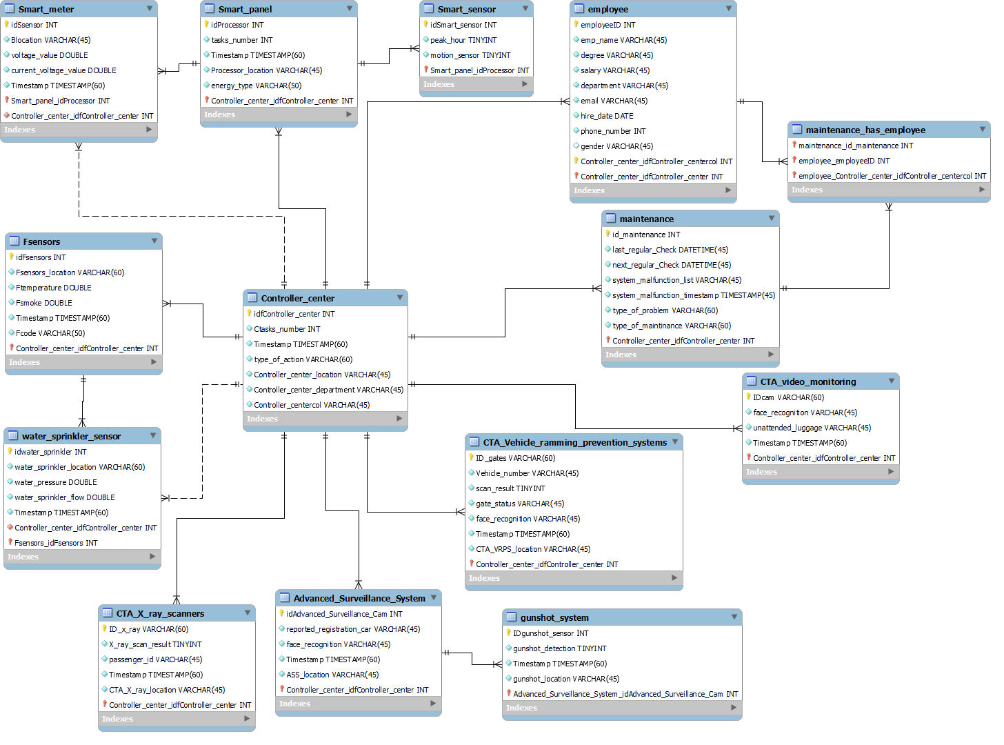

Slide 8
Design And Implement Organizational Systems And Documentation
2

Slide 9
Business Model
Our business model is B2B. We R company provide (Fire system, Blackout prevention system, surveillance system and CTA system) to medium-large business/governments.

Slide 10
KPIs and Dashboard Demo

Slide 11
Develop Organizational Data Awareness Training Programs
3
(Surveillance System)

Slide 12
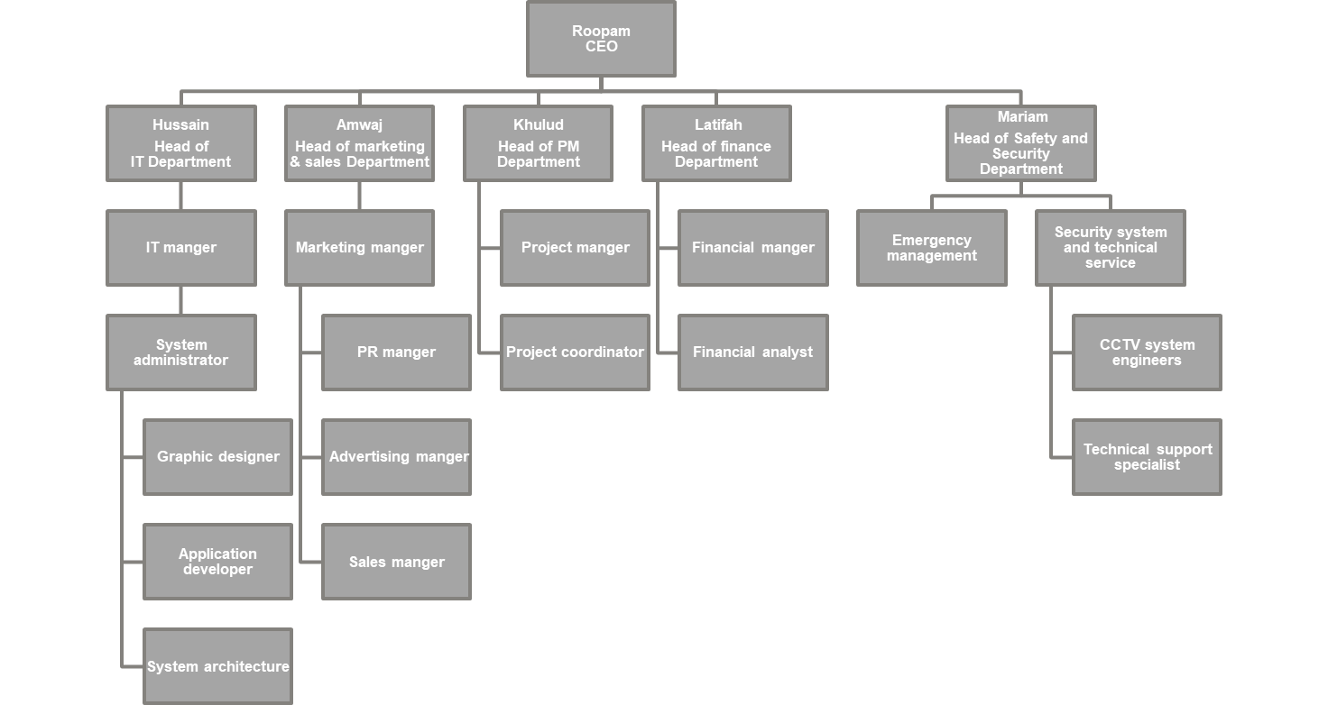

Slide 13
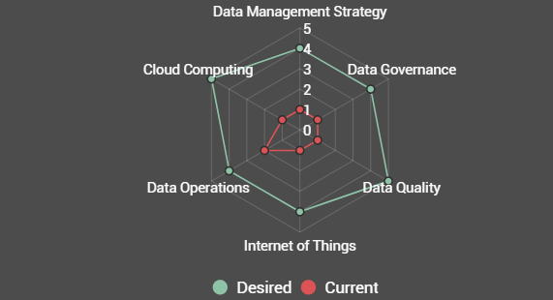
Maturity Assessment

Slide 14
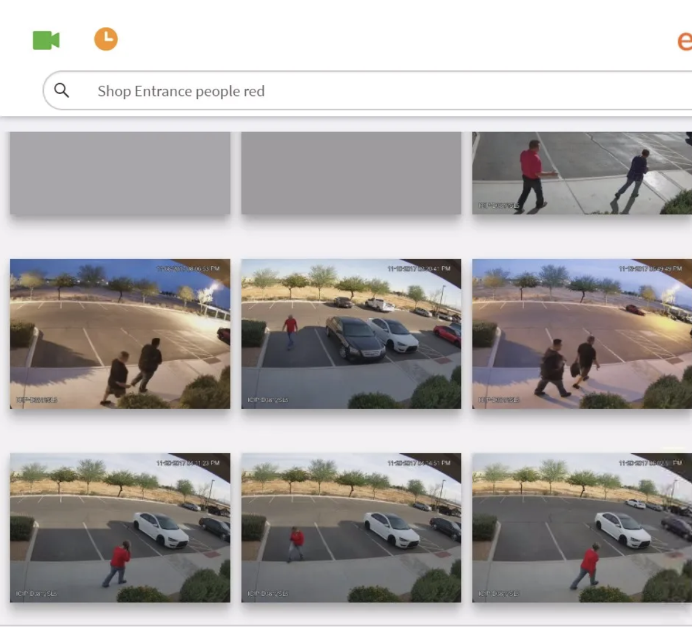
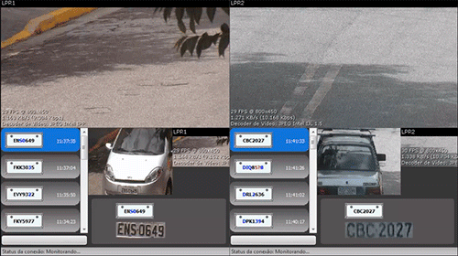
Smart Surveillance Features
Automatic Search
Real-time Analysis
Capable of analysing the footage in real-time.
Action will be taken within acceptable time frame.
AI analysis can handle many tasks in parallel.
Accurate searchable feature.
Instant results.
Reduce Human intervention.

Slide 15
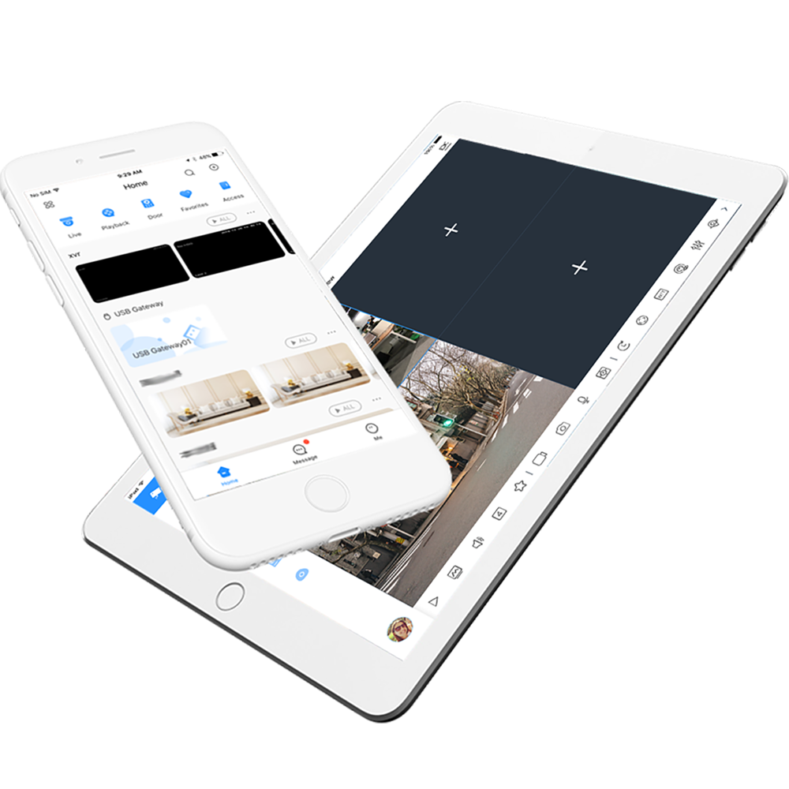
Smart Surveillance Features
System Integration
System is connected to the cloud, no wire connections is needed.
Connected to multiple devices by creating new profile only.
Accessed anytime and anywhere.
Compatible application to be used for any smart device.
Integrated to ML models to analyse the footage in real time.

Slide 16
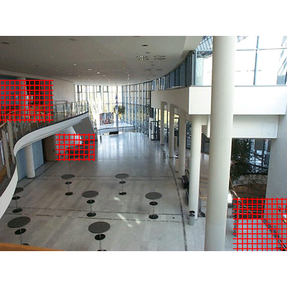
Smart Surveillance Features
Motion Detection
Restricted areas are identified first.
Any motion detected inside the boundaries of the restricted areas are detected automatically.
Alarm is sent automatically to the responding unit.

Slide 17

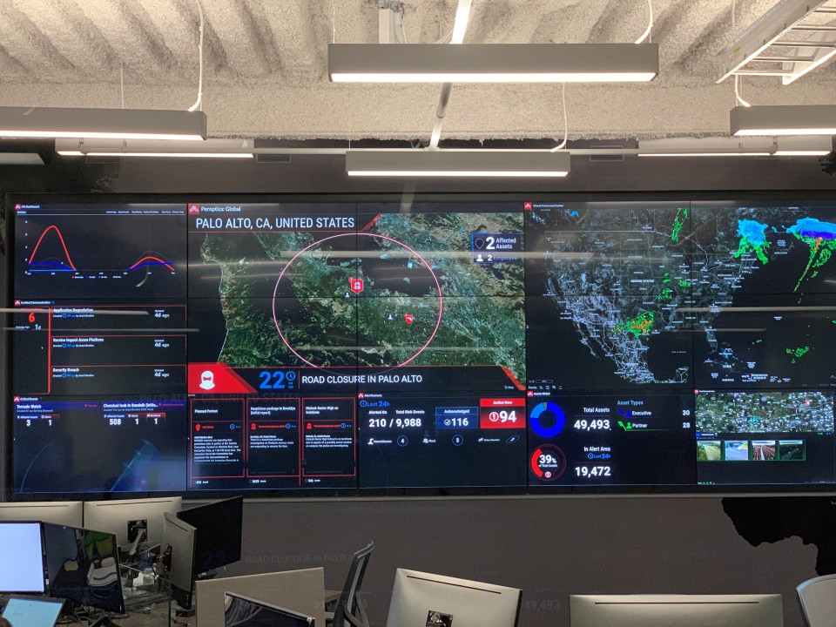
Smart Surveillance Features
Predictive Maintenance
Automated Alerts
Maintenance in smart CCTV is preventive, corrective and predictive.
Alerts are sent in real-time to the control centre.
Responding units are informed directly to attend the scene.

Slide 18
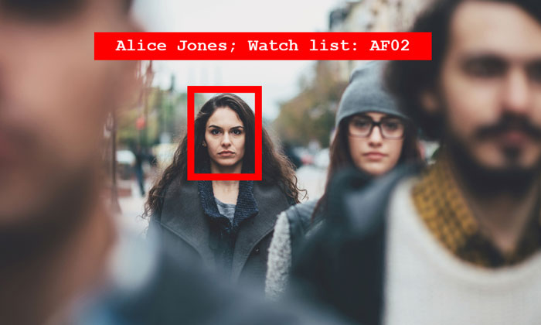
Smart Surveillance Features
Facial Recognition
Done by AI models without human interversion.
Identifying multiple people in parallel.
Identify fugitives and missing persons.
Automated surveillance at lookout locations.
Used with dornes to large areas during mass events.
Strengthens security measure in banks and airports.

Slide 19
Real Life Case Scenario
Traditional Surveillance Scenario:
09:34:00 | Criminal appeared to carry a gun
09:36:00 | Shooting happened resulted in casualties
09:37:00 | Member of the public reported the crime
09:38:00 | Police forces and ambulance received the report
09:43:00 | Police attended the scene
09:47:00 | Police arrested the criminal
09:48:00 | Ambulance arrived at the scene

Slide 20
Real Life Case Scenario
Smart Surveillance Scenario:
09:40:59 | The smart system detected guns
09:40:59 | Alarm is sent to the control centre
09:41:01 | Control Centre sent an alarm to the public in that area to stay indoors
09:41:01 | Control centre is monitoring the situation waiting for the police arrivals
09:43:32 | Police attended the scene
09:45:05 | Police arrested the criminal
09:45:11 | Ambulance arrived at the scene

Slide 21
Real Life Case Scenario Comparison
Action | Traditional | Smart
Crime Reporting | Member of Public, CCTV operator | Automatically
Responding Unit Alert | Control Centre | Automatically
Public Alert | —- | Automatically
Facial Recognition | Drawing, Manual | Automatically
Time frame | High | Low
Human Resources | High | Low
In Parallel Reporting | Difficult | Easy

Slide 22
Purpose of Adapt Smart Surveillance System
Cloud Computing:
Scalability: Increase or decrease IT resources as needed to meet changing demand.
Quick Deployment: deploying new computing instances or software in matters of seconds.
Data Security: Cloud Provides many advanced security features that guarantee that data is securely stored and handled.
Backup and Disaster Recovery: Production instances are running in multiple cloud availability regions to allow for faster recovery from disaster and securing the back-ups.

Slide 23
Purpose of Adapt Smart Surveillance System
Internet of Things:
Automation: Direct communication between separate devices and other hardware without human interference.
Connectivity: Enhanced connections within one network on a worldwide scale provide easy access to varies information.
Adapting to New Standards: Minimal changes required compared to other techs.
Cost Reduction: with predictive maintenance and reducing labor costs.

Slide 24
Roadmap
May 22
Oct 22
Oct 23
Current System Evaluation
Smart Devices
Employee Training
Jul 22
May 23
Feb 24
Cloud Computing
Data Migration
Deployment

Slide 25
IoT Components for Implementing the System
Devices
Gateways
Cloud Gateway
Data Lake
Big Data warehouse
Data Analytics
Machine Learning and the Models ML Generates
User Applications

Slide 26




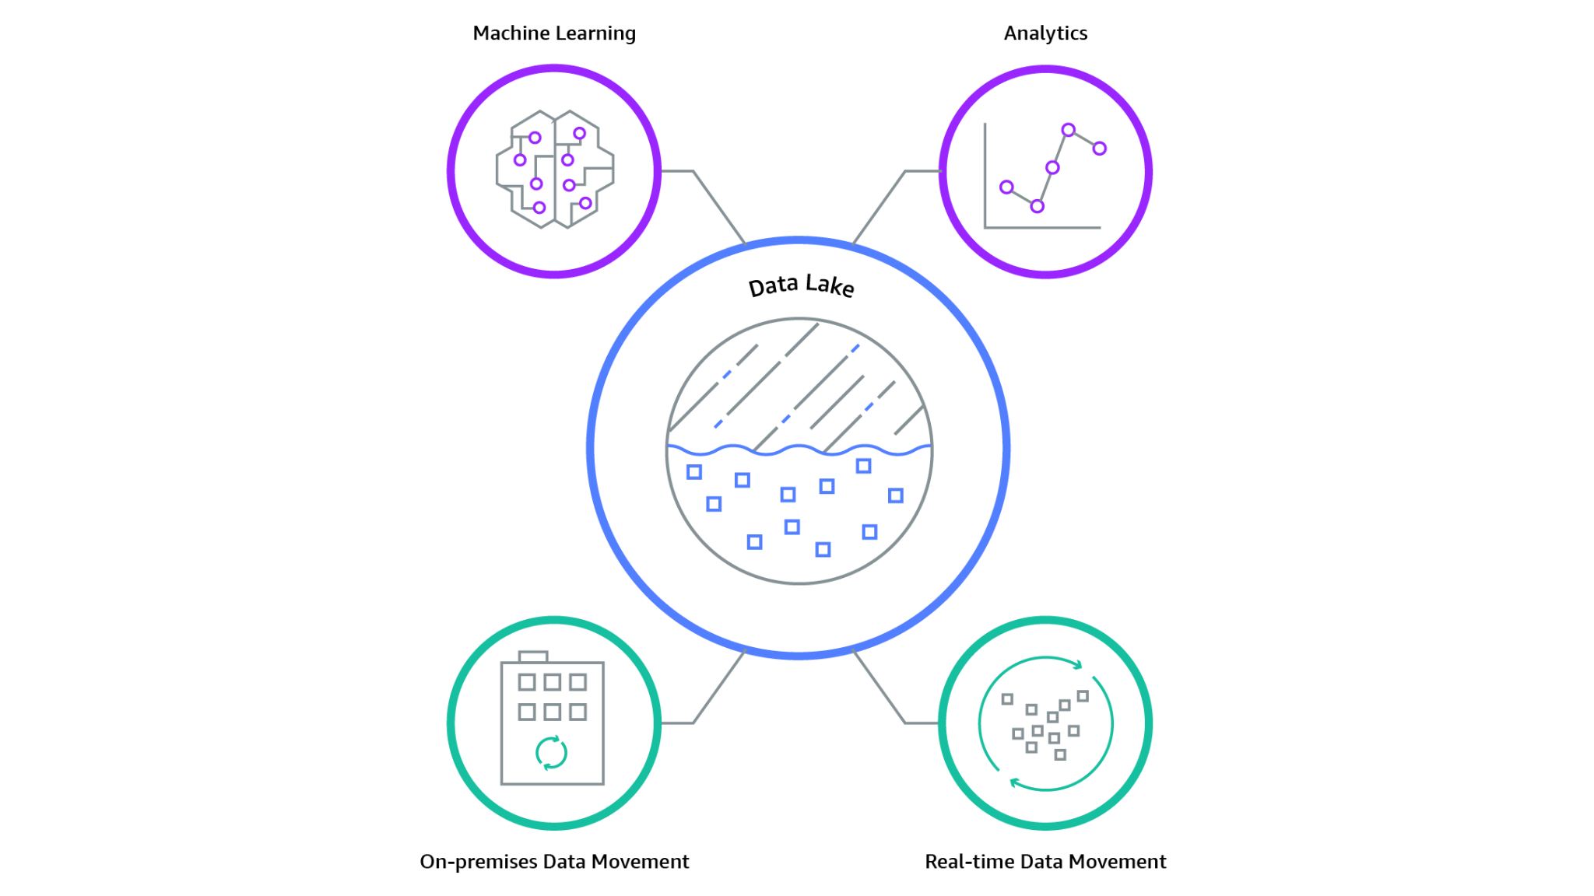



Surveillance System Architecture
Machine Learning
Analytics
Devices (things)
User
Applications
Data Lake
Raw Data (Unstructured)
Cloud
Gateway
On-premises Data Movement
Real-time Data Movement

Slide 27
Collected Data
 | Structured Data | Unstructured Data
Formats | Several Formats (csv, xls) | A huge variety of formats (jpg, mp4)
Storages | Data warehouses | Data lakes
Databases | Relational Databases (SQL) | Non-relational databases (NoSQL)
Analysis | Classification Regression Data clustering | Data stacking Data mining
Specialists | Business analysts Software engineers Marketing analysts | Data scientists Data engineers

Slide 28








Data Management tools
1
2
Unstructured Data
Structured Data

Slide 29



Data Security
Authentication
SQL authentication.
Active Directory authentication.
Enable Multi-Factor authentication.
Minimize the use of password-based authentication for users.
Create and manage access groups.
Create separate group for DB administrators for each server.
Monitor group membership changes.
Identify the required level of separation of duties.
identify a comprehensive hierarchy of users.
Central Management for Identities
Separation of Duties

Slide 30



Data Security
Encrypt data at rest and in transit.
Encrypted data at rest should not be stored in the master database.
For Encrypted data in transit, network should be secured by applying Transport Layer Security (TLS).
Input validation and parameterized queries should be applied to prevent SQL injection.
Access auditing and monitoring to prevent or contain credentials theft or leak.
Trace logs should be monitored to prevent privilege abuse.
A regular classification of sensitive data should be performed.
A regular audit of groups access should be monitored.
Data Encryption
Protect DB against Attacks
Identify Sensitive Data

Slide 31
Artificial Intelligence
As collected data would be used for machine learning models, IT department should ensure the following:
Consistency of data across all systems.
Support all the data formats generated by the systems.
Scaling the servers computation powers to apply machine learning models.
Build a responsible AI by consider the following:
Fairness: AI system should treat all people fairly.
Reliability & Safety: AI system should perform reliably and safely.
Privacy & Security: AI system should be secure and respect privacy.
Inclusiveness: AI system should empower everyone and engage people.
Transparency: AI system should be understandable.
Accountability: People should be accountable for AI systems.

Slide 32

Backups
Regular and Frequent Backups.
Encrypt and Protect Backups.
Store backups on multiple hosts and regions(On-premise and Cloud).
Specify appropriate retention policy.
Monitor data backup jobs.
Testing Restores.

Slide 33
Disaster Recovery
Plan a disaster recovery plan to return to switch to DR servers immediately after a disaster has struck.
Identify and assess disaster risks.
Determine critical applications and resources.
Test the plan with realistic scenarios.
Plan for resuming normal operations.
Office Facility Destroyed
Power Disruption
Disaster
Staff Can’t Report to Work
Data System Destroyed
Telecom Failure

Slide 34
Thanks!
24 • 02 • 2022
Do you have any questions?
Wercompany@Wer.com.sa
Wercompany.com.sa

